Slide 1
Direct reaction
Y.-H. Song(RISP,IBS)
2017.July.05 The 2nd RISP Intensive Program on Rare Isotope Physics

Slide 2
Previous lecture, we considered non-relativistic elastic scattering without considering structure of particles
However, in nuclear physics, each target and projectile have internal structures which can change during the nuclear reaction.
In this lecture, we will consider direct reactions including non-elastic channels.
Only basic concepts will be explained. For more details can be found in many books and lectures(for example, TALENT6 lectures)

Slide 3

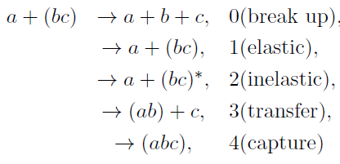
Partition, Channel
Reaction Q-value:
(Released energy)
Suppose target is composed with two particle
(Mass) partition : projectile (Z,A)
and target (Z,A) combination
Channels : projectile and target quantum states
(spin, parity, excited states )
many-body problem , (Ap+At)-system.
Many different reaction channels.
We have to use approximations/simplification.
( reduce the problem into few-body problem, reduce relevant channels, etc. )

Slide 4
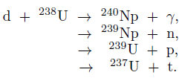
Conservation laws in nuclear reaction
Baryon Number
Charge
Energy and linear momentum
Total angular momentum
Parity
(approximate) Isospin
initial S-wave capture → L=2,3,4 final states , parity imply L=3

Slide 5
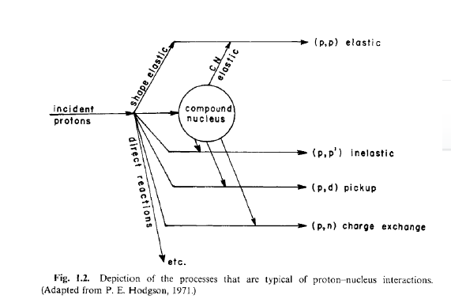

Direct reaction and Compound Nucleus reaction
Direct reaction(D) and
Compound nucleus(CN) reaction
Reaction time: D → short
CN → long
Contact: D→ glancing contact (surface)
CN→ involve whole nucleus
Angular distribution:
D→ forward peak
CN→ isotropic
Independence hypothesis of CN reaction

Slide 6




wave function
Simplification of many-body wave function :
sum of channel wave functions
(bound state wave functions of projectile and target)
and (wave function for relative motion)
Suppose Bound-state wave function is known from structure model
Relative wave function determines the flux → cross section
b
a
A
B

Slide 7
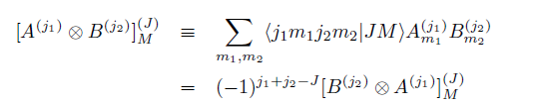
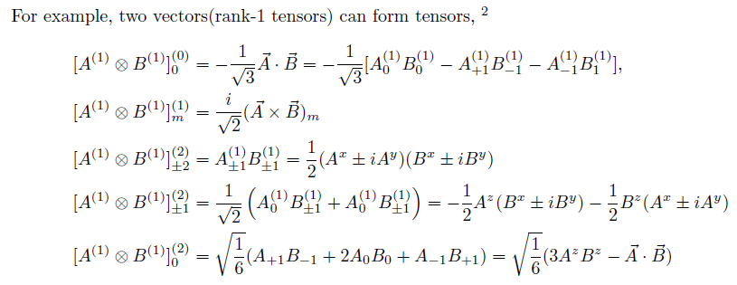
Angular momentum coupling
Projectile and Target Nucleus have states (spins, parity, internal wave function)
To have a specific total angular momentum,
specific combination of orbital and spins are necessary.
Combination of Tensors
(Order is important)

Slide 8



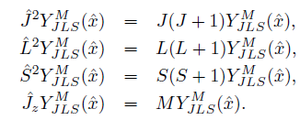
Angular momentum coupling
We can combine spin and orbital angular momentum to have total angular momentum J
(H.W.) verify relations
We can combine multiple angular momentums.
For example, projectile and target with total angular momentum J

Slide 9
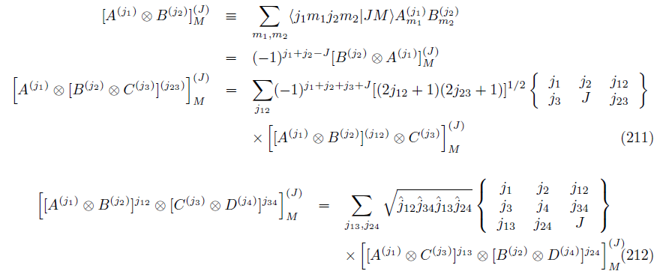
Angular momentum recoupling
Recombination: C.-G., 6-j symbol, 9-j symbol …

Slide 10
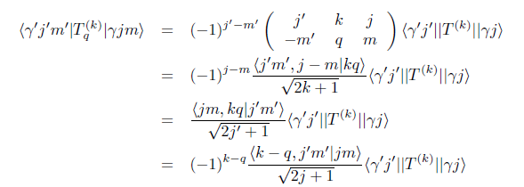


Wigner-Eckart theorem
Reduced Matrix element is independent of z-projections
Coulomb reduced matrix element
Reduced transition probability

Slide 11
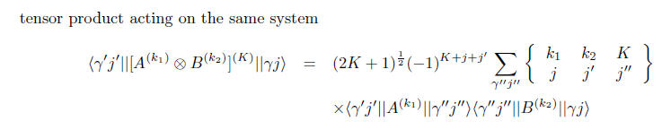
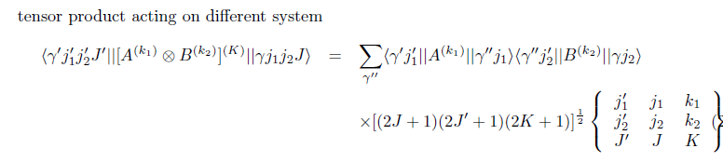
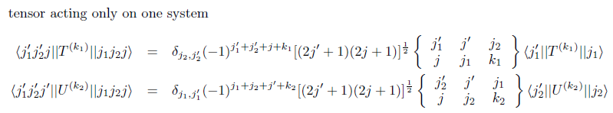
Reduced matrix element for tensor product

Slide 12
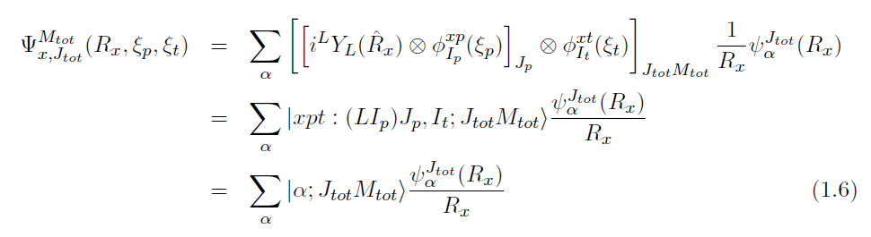
Wave function
Wave function of a channel with specific total angular momentum : J= L+Ip+It
J-basis (LS ) scheme : add (orbital angular momentum)+(projectile spin) first
→ Diagonal for the (projectile) spin-orbit interaction.
S-basis (JJ ) scheme : add (projectile spin)+(target spin) first
Conversion between the two scheme can be done

Slide 13

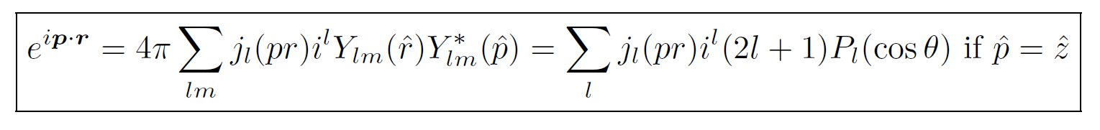
Wave function
Partial wave expansion of scattering wave:
Scattering wave function with incident momentum k
and initial spin states of projectile and target
Recall
Our Object: obtain (relative) wave function in each channel
and compute the cross section in each channel

Slide 14


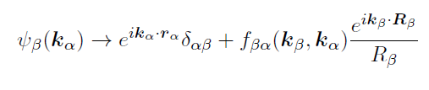

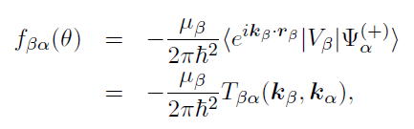
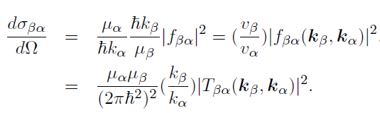
Cross section
S-matrix (for reaction)
Cross section (for reactions)

Slide 15
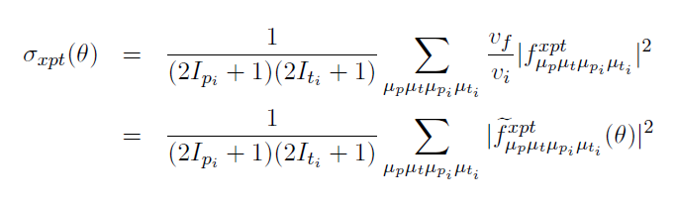
Cross section
Unpolarized (spin averaged) cross section
How to compute the channel wave function?

Slide 16


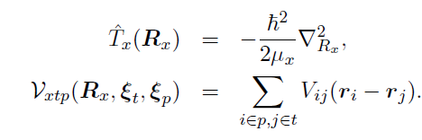



Coupled Reaction Channel equation
Model space wave function
Suppose we separate full many-body Hamiltonian
Into (projectile)+(target)+(relative)
Expand for each channels

Slide 17


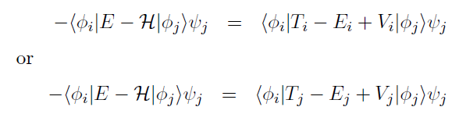


Coupled Reaction Channel equation
Left hand side
Ei : channel energy➔ kinetic energy in partition/channel
Separation of Hamiltonian is not unique
Right hand side

Slide 18
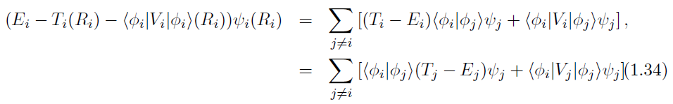

Coupled Reaction Channel equation
Couplings involve an integration of bound state wave functions and potential
Over internal coordinates.
By solving Coupled Reaction Channel equation,
We get the channel wave functions, and thus reaction cross section.
However, it is quite complicate equations → Simplification?
Optical potential

Slide 19



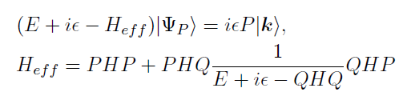
Optical Potential
Projection operator
Effective Hamiltonian
Acts only on P(model space)
Complex
Negative imaginary potential
→ loss of a probability flux
from model space
4. non-local
Theoretically we may compute effective Hamiltonian.
In practice, effective potential are fitted to experiments.
Optical potential in elastic channel simulates the neglected model space contributions

Slide 20
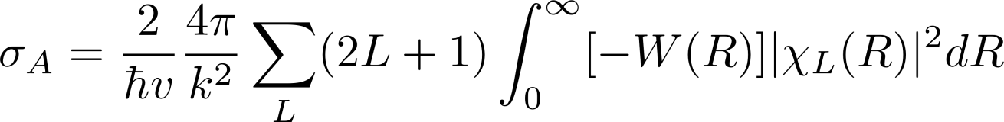
Elastic scattering (Optical Model)
Complex optical potential are usually fitted to reproduce elastic scattering data.
In optical model of elastic scattering,
we approximate all other reaction channel effects
into a complex optical potential.
Woods-Saxon Form is commonly used for parametrization
Optical potentials
Surface potential, spin-spin interaction and so on…
Negative imaginary potential implies reduction in flux in elastic channel
→ Absorption cross section
(H.W.) prove this is the same
As the reaction cross section
For spherical potential
(hint) Use Schrodinger eq.

Slide 21
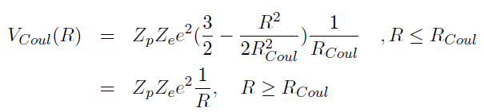



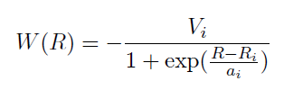
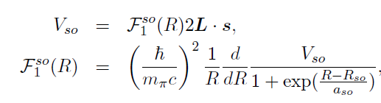
Elastic scattering (Optical Model)
Coulomb
a: diffuseness
Real part
Imaginary part
Spin-orbit interaction

Slide 22
Elastic scattering (Optical Model)
Typical values are Vr~ 40-50 MeV, Vi~ 10-20 MeV, Vso~ 5-8 MeV
r ~ 1.2 fm, a~ 0.6 fm
Parameters depends on projectile, target and energy
Sometimes global optical potential available or
one can use folding potential
Global Optical Potentials: RIPL-3 https://www-nds.iaea.org/RIPL-3/
Folded potential: nuclear density + effective NN interaction(M3Y , JLM etc. )
single folding or double folding

Slide 23
Elastic scattering (Optical Model)
There are many optical model codes.
Parametrization of optical potential depends on the code.
Thus, one have to check each code for its own conventions.
https://people.nscl.msu.edu/~brown/reaction-codes/
For given Optical potential, how to get the cross section?

Slide 24
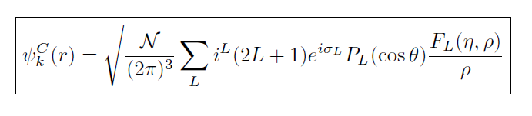
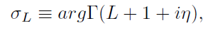
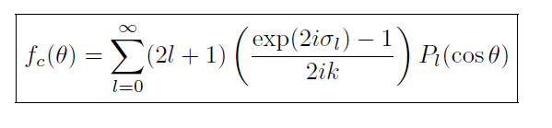

Coulomb Scattering
1. Coulomb interaction is a long range interaction:
There is a distortion in wave function even at large separation.
2. Coulomb scattering can be solved exactly. → Coulomb function
Coulomb phase shift
But, this form have bad convergence,
Instead we can use
Rutherford Cross section

Slide 25

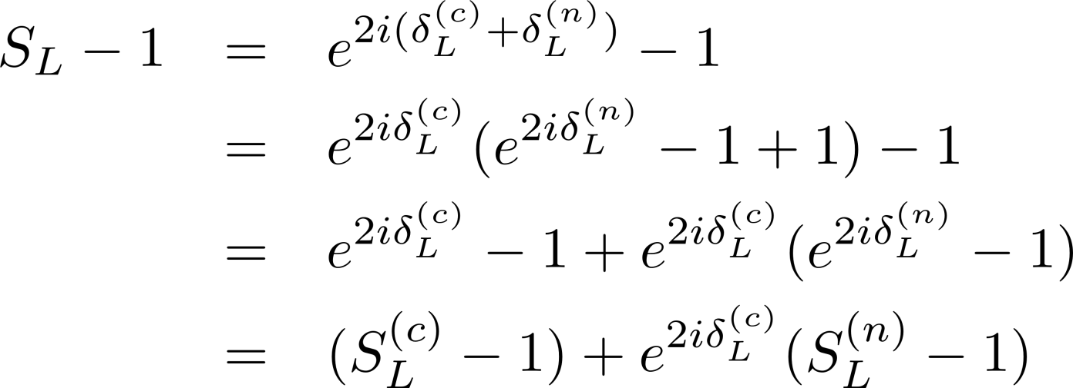
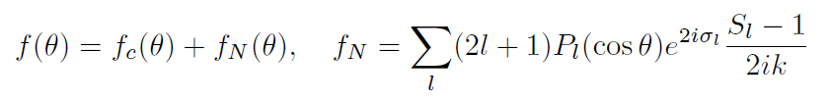
Coulomb + Nuclear Scattering
When there is a strong interaction, we have additional nuclear phase shift
(Note) this expression assumes spherical potential

Slide 26
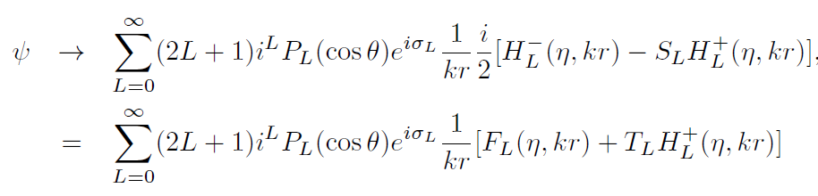
Coulomb + Nuclear Scattering
Nuclear S-matrix can be obtained by matching numerical solution
with asymptotic form
Note the nuclear scattering amplitude is not from nuclear interaction only
The cross section will have interference between Coulomb and Nuclear amplitudes
Usually elastic scattering cross section are plotted as ratio to the Rutherford cross section

Slide 27
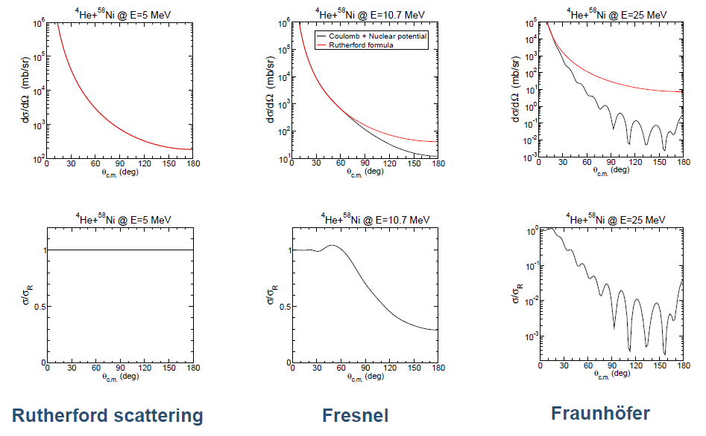
Elastic scattering (Optical Model)
Nuclear Reaction Video (NRV) provides easy access to some nuclear reaction calculation
http://nrv.jinr.ru/nrv/
Typical
energy dependence
(A.M. Moro’s lecture)

Slide 28
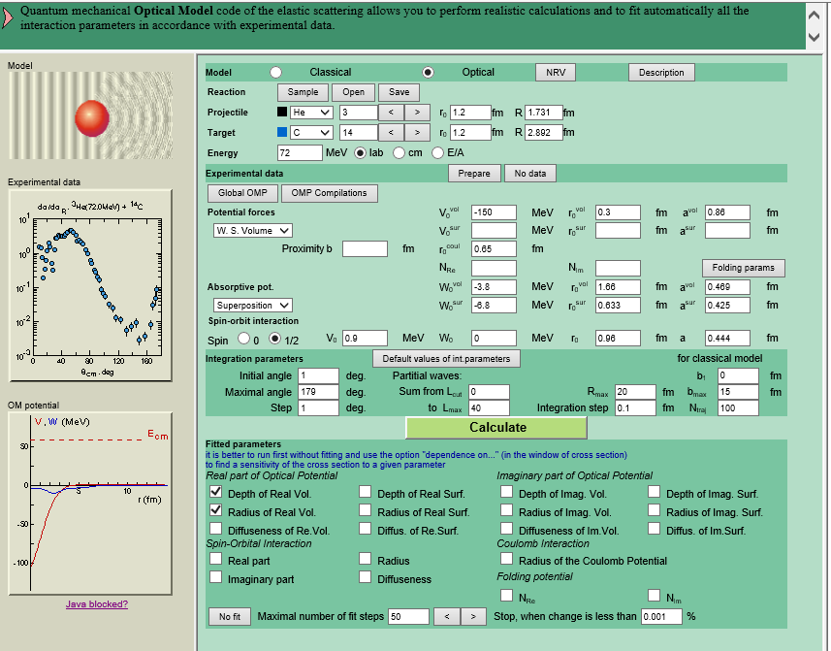
Elastic scattering (Optical Model)

Slide 29
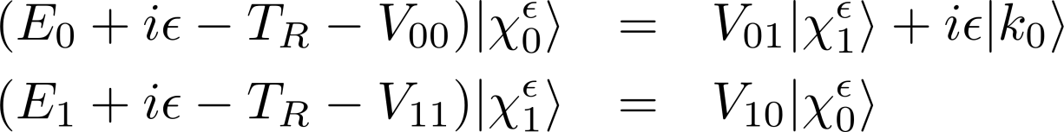

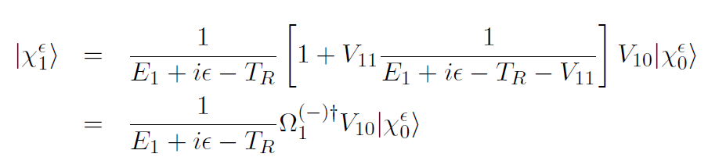
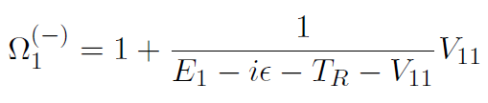
DWBA for non-elastic reaction
Consider two channels
This operator acts as Moeller operator
When acting on free |k1> state

Slide 30
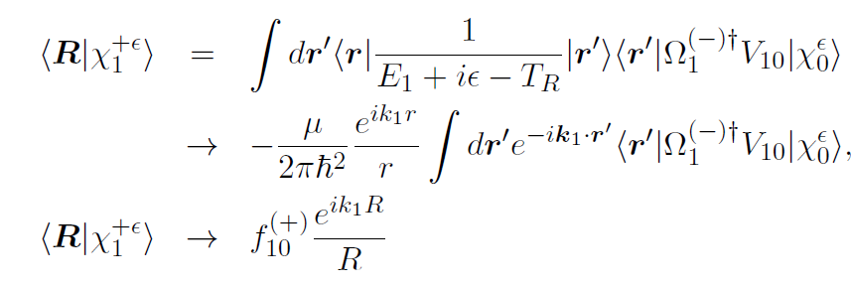


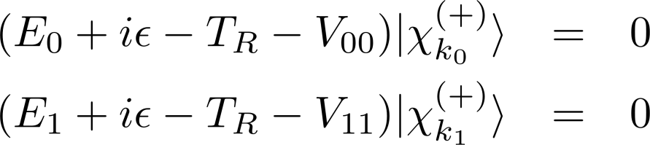
DWBA
Ignoring V_{01} coupling term → DWBA approximation

Slide 31
Inelastic scattering (Rotational Model)
Coupling to inelastic channel requires structure information (models)
For inelastic scattering: Commonly used models are
Collective Excitation Model : Rotational or Vibrational
Or
Single Particle Excitation Model
Rotational Model

Slide 32



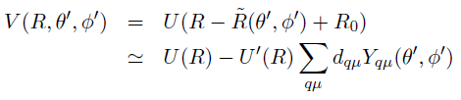
Inelastic scattering (Rotational Model)
Rotational Energy of deformed nuclei
(even-even or odd-odd Nuclei case)
I
K
Symmetry axis
I : spin of nuclei
K: bandhead ,
Spin projection at body-fixed frame
Deformed Nucleus
In z’-axis, R0(1+beta)
Deformed potential
R

Slide 33



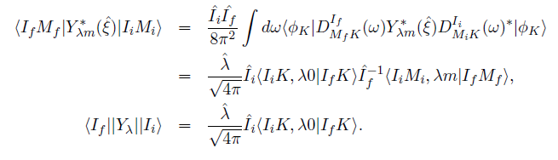
Inelastic scattering (Rotational Model)
Axially deformed case : deformation length, fractional deformation
Skipping calculation of transition matrix for change of rotational state

Slide 34

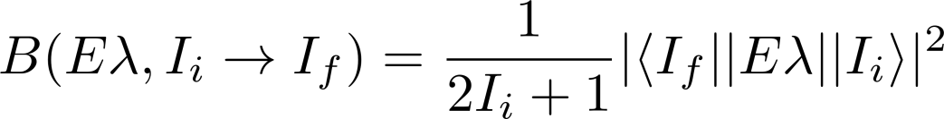
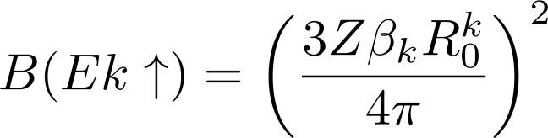
Inelastic scattering (Rotational Model)
Axially deformed case : deformation length, fractional deformation
Skipping calculation of transition matrix for change of rotational state
In simple rotational model,
Deformation length(or beta) is an input.
Deformation → Coulomb and Nuclear
(may differ)
Reduced transition probability

Slide 35
Inelastic scattering (Rotational Model)
There are many DWBA codes for inelastic scattering in collective model.
https://people.nscl.msu.edu/~brown/reaction-codes/
Requires
Incident Energy and Q-value
Optical potential between projectile and target
(3) Information for initial state and final state, transferred orbital angular momentum
(4) Information for deformation
NRV provides easy access to rotational model calculation
of inelastic scattering

Slide 36
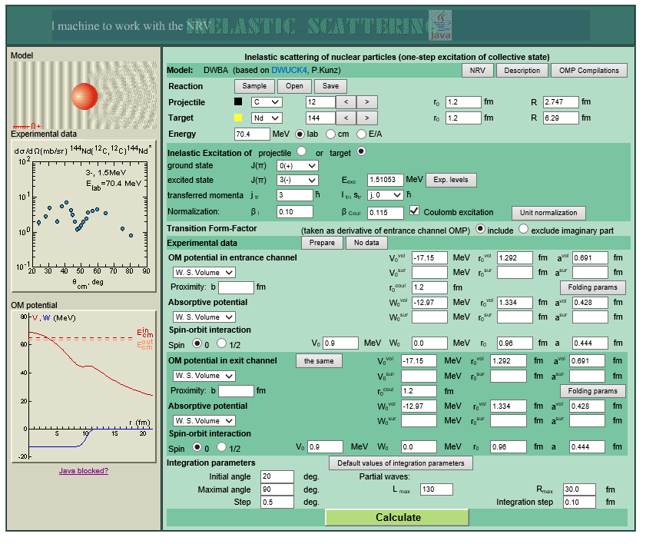
Inelastic scattering (Rotational Model)

Slide 37
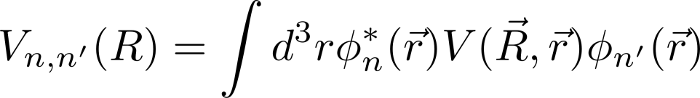


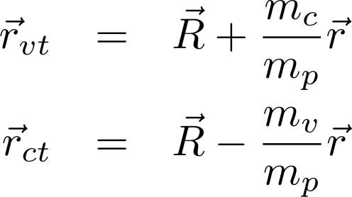

Inelastic scattering (Single Particle Excitation Model)
Model the bound state of a nucleus as (core)+(valence particle)
Bound state is characterized by (valence particle wave function)
Inelastic excitation corresponds to the change in bound state wave function
v
r
c
R
T

Slide 38
Inelastic scattering (Single Particle Excitation Model)
One can introduce auxiliary optical potential for entrance/exit channel.
Then transition potential becomes
During inelastic reaction, target and core are spectators.
(also spin of valence particle does not change)
Orbital angular momentum (Li→ Lf) and
relative angular momentum in bound state (li → lf)
Changes by the potential.
Thus, it is convenient to decompose the potential in multipole operators

Slide 39
Inelastic scattering (Single Particle Excitation Model)
Changes bound state l
Changes orbital L

Slide 40
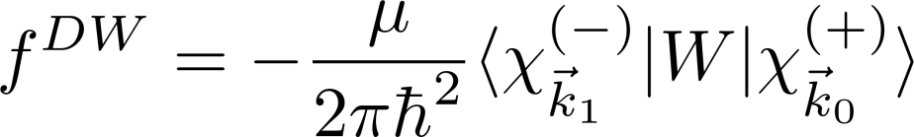
Inelastic scattering (Single Particle Excitation Model)
In some code,
The last two terms are neglected
DWBA calculation requires
Kinematic info ( incident energy, Q-value)
Initial and Final State, transferred angular momentum
Optical potential between projectile and target
Initial and final Bound state wave function → binding interaction, spectroscopic factor
Inelastic (residual) Potential
DWBA codes are available: DWUCK, TWOSTP, …
https://people.nscl.msu.edu/~brown/reaction-codes/

Slide 41







Transfer reaction
Consider the stripping reaction,
p(=c+n)+c’ → c+t(=c’+n)
In rearrangement,
initial and final partition is different.
n
c
c’
p=c+n
t=n+c’
Need to evaluate

Slide 42

Transfer reaction
n
In general this coupling gives
Non-local kernel
Finite-range transfers
Local approximation of kernel
Zero-range transfers
(treat interaction potential
as approximately zero range )
c
c’
p=c+n
t=n+c’

Slide 43
Transfer reaction
DWBA amplitude involves integration of kernel with channel wave functions,
We can change the variables, into
So that the kernel can be calculated by the integration over angles of R and R’

Slide 44
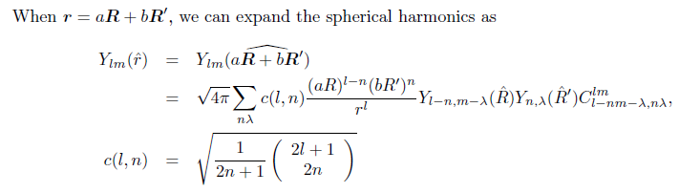

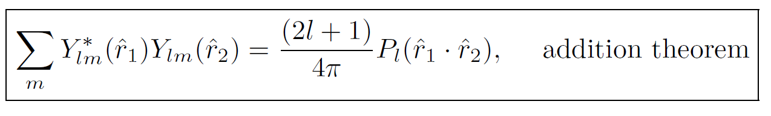
Transfer reaction
Use Moshinsky solid-harmonic expansion
And Legendre polynomial expansion

Slide 45


Transfer reaction (Zero range)
In some case,
When remnant terms are negligible
Wave function are all s-waves
Interaction potential is approximately zero range
In some code using ZR approximation,
input becomes D0
instead of transition potential and bound state wave function
Typical value for deuteron

Slide 46
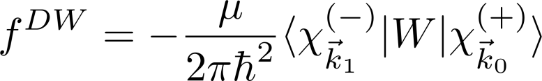
Transfer reaction
In some code,
The last two terms are neglected
DWBA calculation requires
Kinematic info ( incident energy, Q-value)
Initial and Final State, transferred angular momentum
Optical potential between projectile and target
Initial and final Bound state wave function → binding interaction, spectroscopic factor
Transition Potential
DWBA codes are available: DWUCK, TWOSTP, …
https://people.nscl.msu.edu/~brown/reaction-codes/

Slide 47
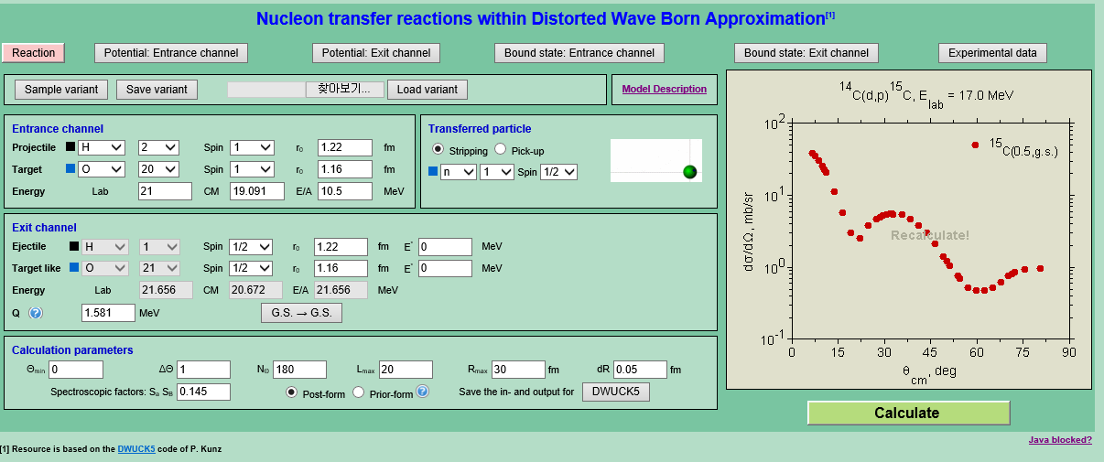


Slide 48





Overlap function, Spectroscopic factor, ANC
Overlap function: For B=A+v
In principle, overlap function comes from many-body calculation.
It is common to use a simple single-particle picture.
To be exact, Anti-symmetry
of wave function have to be considered
Spectroscopic factor
B
r
A
Spectroscopic amplitude

Slide 49




Overlap function, Spectroscopic factor, ANC
From the nucleon separation energy, we expect
Asymptotic Normalization Constant
If we approximate many-body overlap function into s.p. wave function
Well-depth prescription is
Commonly used for s.p.w.
Single particle ANC

Slide 50


Transfer reaction as a spectroscopic tool
Transfer reaction cross section is sensitive
To the transferred angular momentum
(1) By analyzing angular distribution,
one can determine
the transferred orbital angular momentum
The quantum number of s.p. states
(2) In a s.p. picture,
one can extract S.F. from experiments
→ Spectroscopic information
DWBA codes are available: DWUCK, TWOSTP, …
https://people.nscl.msu.edu/~brown/reaction-codes/

Slide 51

Three-body problem
Basically we approximate many-body reaction
into a few-body problem (mostly two-body problem).
Exact way to solve few-body problem
3-body→ Faddeev equation
4-body→ Faddeev Yakubovsky equation
When we remove the center of mass motion, the system is described by
Jacobi coordinates (equal mass particles)

Slide 52





Channels in three-body
Let us ignore
Possible 3-body interaction
And couplings to break up
Channels
For simplification
Channels

Slide 53




Three-body LS equation
Moller channel operator
Channel resolvent

Slide 54



Three-body LS equation
Lippmann’s identity
We get triad of three-body equation
Three-body LS equation
However, solving Three-body LS equation alone cannot give unique solution
The simultaneous solution of triad equation→ gives unique solution

Slide 55




Faddeev equation
Solving triad equations is equivalent to solve Faddeev equation
Faddeev component
Faddeev equation

Slide 56





AGS equation
If we convert the equation, in terms of transition amplitude,
We get AGS(Alt-Grassberger-Sandhas) equation
AGS equation

